Slide 1
Berkana
Advisory and Investment Platform for Green Solutions
SEC final registration (pending) FINRA #319299

Slide 2
Our Firm
Berkana Private Equity, LLC manages a global platform of advisory, green investments, and institutional fundraising.
The Berkana team includes professionals and partners with extensive experience in providing green solutions.
Berkana enhances the value of local investments by partnering with experienced global and local technology solutions providers.
Berkana conducts business with the highest environmental and governance standards for its clients.

Slide 3
Our Team
Berkana has a premier team of private equity professionals, energy executives, and technology partners.
The team has over 35 years of experience analyzing and structuring investments in energy companies and global investment funds.
Berkana's professionals have a successful investment track record in over 100 countries.
The team is highly motivated to advance the global green economy sector.
Berkana is developing strategic alliances with world-class technology partners to offer credible expertise and tested technologies.

Slide 4
Our Services
Investing in climate change
Structuring club deals
Advising climate-related projects and solutions ​
Promoting and advising green projects and new technologies
Fundraising amongst Institutional Investors

Slide 5
Areas of Focus
Green Economy Zone:
Renewable energy
Forestry
Manufacturing
Tourism
Fishing
Buildings and housing solutions
Transport
Agriculture
Waste

Slide 6
Fundraising
•Berkana has applied for SEC-FINRA’s Capital Acquisition Brokers’ license to allow fundraising amongst institutional investors.
•Berkana aims to facilitate the linkage between private and public funding for green projects.
•Berkana has a successful working relationship with more than 200 institutional investors.

Slide 7
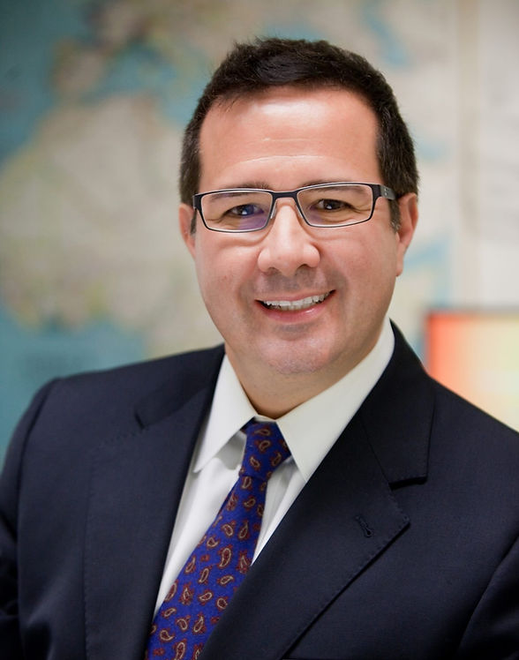
Contact
Sergio Pombo
Email: Sergiopombo@berkanape.com
Phone:+1 (202) 471-0428
Washington, DC USA

